Slide 4
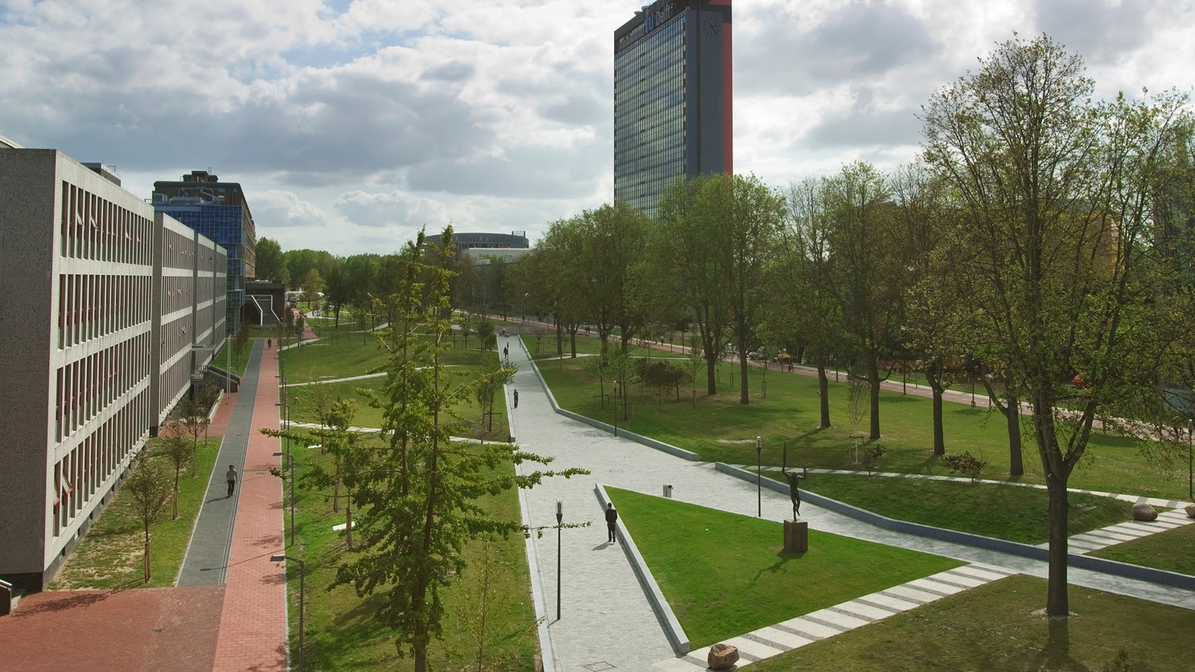
Insert a picture

Slide 5

Insert a picture

